Slide 1
Werewolf vs. Village
Web game adapted by card board game “Los hombres lobo de Castronegro”
Cristina Ferrer
Oriol Soler

Slide 2
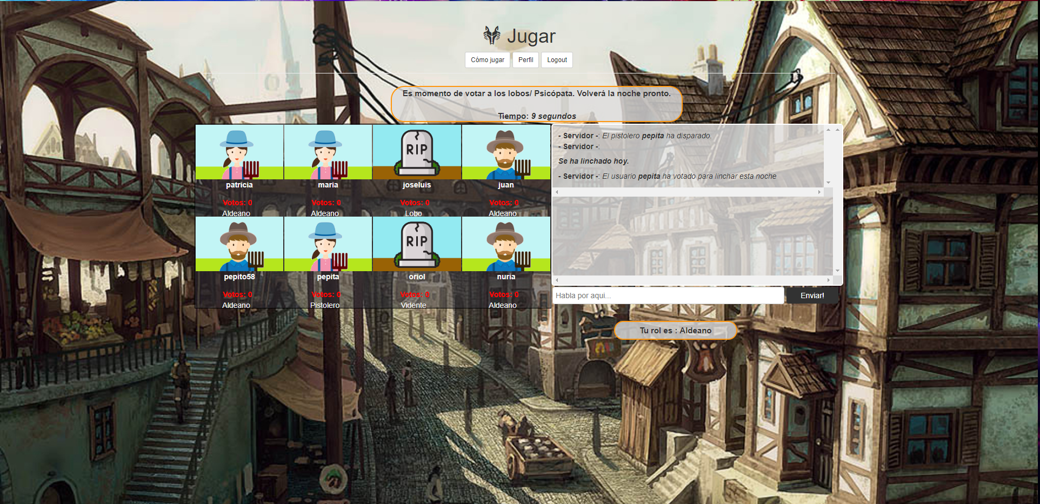
Captura

Slide 3
Abstract
Web game adapted by card board game “Los hombres lobo de Castronegro”
It is made with nodejs, socket.io, Mongodb, Firebase, jQuery and more
There is no need to install anything other than the browser to play.
In this game you will adapt a role and you will have to interpret the best you know.
There are 10 unique roles with each one a special feature.
Those who do their best, will win.
Watch out the fool to not cheat you!

Slide 4







Software used

Slide 5
